Slide 1

Meri Skills Sales Data Analysis
A complete data report for the sales data of the company for the quarter of 2019-20

Slide 2
Outline
Introduction
Purpose of the project
Business Requirements
Steps to Achieve a Clean Report
Findings/Insights
Conclusion
What improvement can be done on the basis of this report?

Slide 3

Introduction
Sales data analysis plays a crucial role in identifying trends, customer preferences, and business performance. By analyzing historical sales data from the year 2019-20, the business(MeriSkill) can gain valuable insights into revenue patterns, product demand, and market behavior. This report aims to examine past sales trends, identify key areas of improvement, and provide data-driven recommendations to enhance business growth.
Through a comprehensive review of sales performance, customer buying patterns, and revenue drivers, this analysis will help in making informed strategic decisions to optimize sales and profitability.

Slide 4

Purpose of the project
Is to evaluate past sales performance, identify trends and gain insights that help improve business strategies.
To help business understand the customer preferences, optimize pricing, forecast demand on the basis of time of day and month, enhance overall profitability.
To analyse to historical data MeriSkill can make informed decision to improve sales efficiency, address challenges and drive sustainable growth.

Slide 5

Business Requirements
What is the overall sales trend?
What is the total revenue generated on the basis of different products?
What is the performance of product on the basis of quantity and price?
What is Order performance per City?
What is the peak period of the day for sales?
What is the revenue contribution between weekdays and weekends?

Slide 6
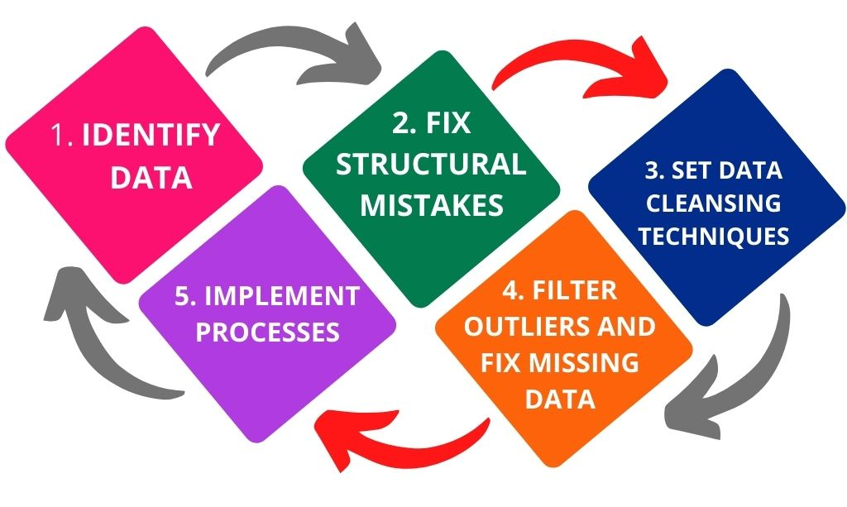
Steps to achieve a clean report
Importing data in the flat files format. Ie converting CSV file format into Microsoft Excel.
Cleaning the data to ensure accuracy of the data and providing standardized reports.
Transformation of data so that it has calculations and measured values. Also added a new column which could be used for better analysis of the report
Visualization of the data using charts, graphs and visuals available on Power BI.

Slide 7
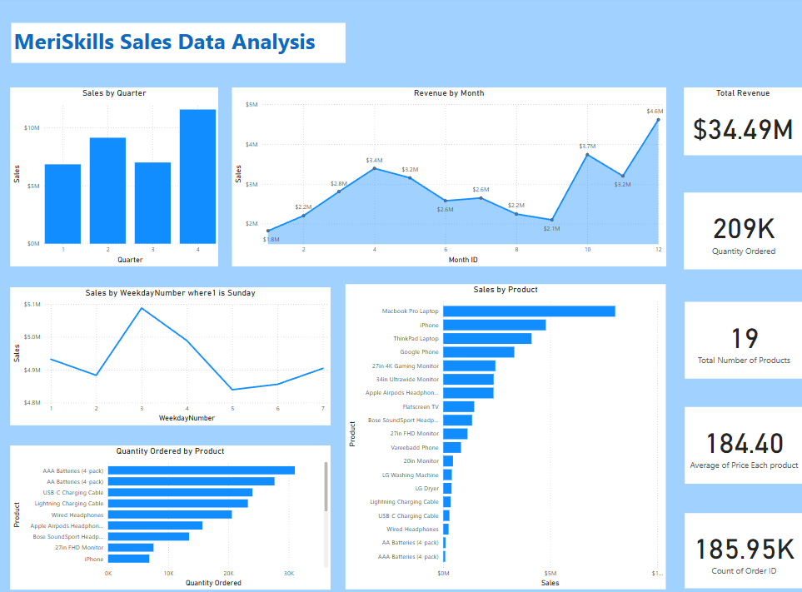
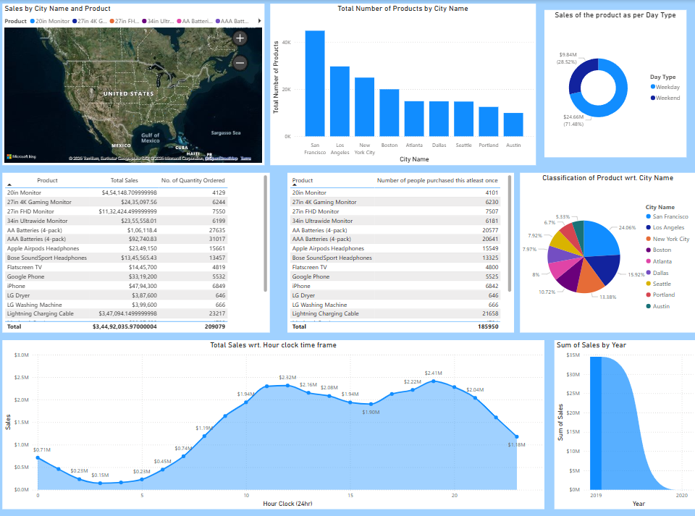
Findings/Outcomes
Power BI report for the dataset provided

Slide 8
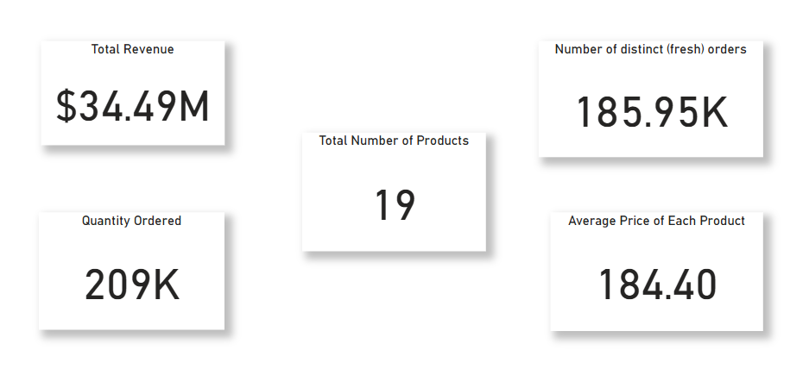
Overview
The report shows the accurate insights about the company’s business. The company made an overall business of $34.49M between the year 2019-20 by selling only 19 unique products they have.
There were 185,950 new transactions made (can be from existing customers or from new ones)

Slide 9
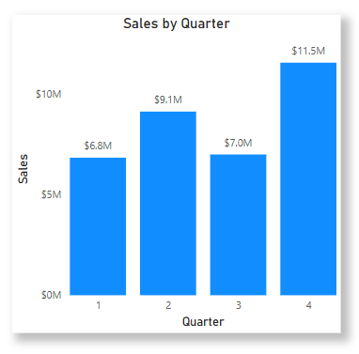
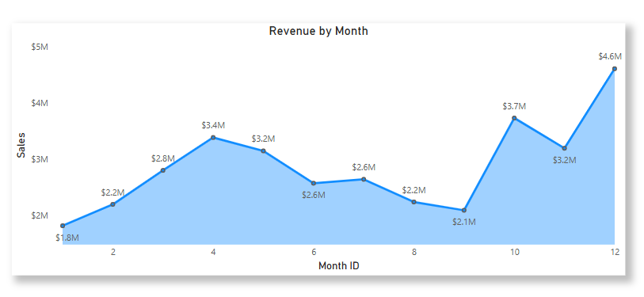
Sales Pattern
This graph evidently explains that the sales in the 4th quarter was higher than comparing other quarters. Difference between the highest and lowest sales is approx. ≈ $4.7M
This graph explains the reports of money made in each month. This shows that towards the end of the year the sales went up high, which resulted in higher revenue generation. The sales were less in 2 month namely January and September, other than this the company had good sales throughout the year.

Slide 10
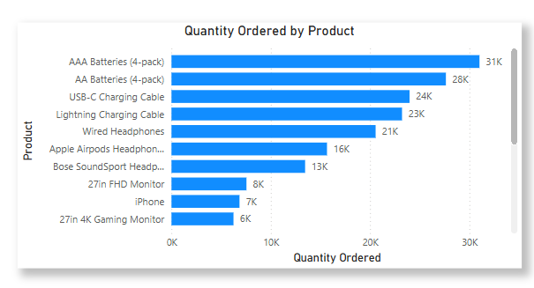
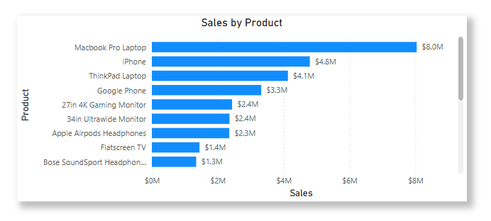
Product Performance
This report gives details of all the 19 products that were sold and the quantity of each. The highest selling item was AAA batteries followed by with AA batteries.
The least selling item is LG washing machine and LG dryer.
This graph tells which products gave the maximum revenue or rolling in form of money. The highest grossed item was MacBook Pro Laptop which had about $8M amount of cash inflow even though only 4728 quantity was sold. While the AAA batteries with highest quantity sold only contributed to $92,740 cash inflow.

Slide 11
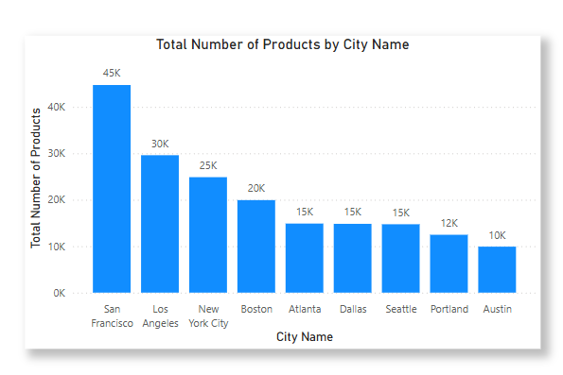
City wise performance
The analysis of city wise sales is also very important to understand where can the company improve its focus to increase the sales more while where can attention be provided to improve the visibility or increase the sales, or where the business is not performing well to terminate the operations there and utilize those funds at a place where the response can be good
San Francisco gave the highest number of products to be sold (44732 products)
While Austin has given the least business comparatively to others. ($1.82M)

Slide 12

Conclusion
Sales Data Insights
Overall Sales Trend: The fourth quarter (Q4) emerges as the highest revenue-generating period, contributing 33.49% of the total revenue, whereas the first quarter (Q1) records the lowest at 19.81%. This highlights a seasonal trend, with sales increasing towards the end of the year.
Monthly Performance: December generates the highest revenue at 13.38%, while January records the lowest at 5.28%, confirming a pattern of lower sales at the beginning of the year and a gradual increase towards year-end.
Daily Sales Trends: Tuesdays contribute the highest revenue at 14.75%, while Thursdays record the lowest at 14%, indicating variations in daily sales performance.
Product Performance by Revenue:
The MacBook Pro Laptop is the top-performing product, generating $8.04M in revenue, while AAA Batteries (4-pack) records the lowest revenue at $900K.
The AAA Batteries (4-pack) is the most sold product, with approximately 31,000 units sold, whereas the LG Dryer is the least sold, with only 646 units.
Order Performance by City: San Francisco leads in order volume, accounting for 24% of total orders, while Austin records the lowest share at 5.33%.
Peak Sales Period: Sales reach their highest point at 7 PM daily, generating $2.4M in revenue, while the lowest sales occur at 3 AM.
Revenue Distribution Between Weekdays and Weekends: Weekday sales dominate, contributing 71.48% of total revenue, while weekend sales account for 28.52%.

Slide 13
What improvement can be done on the basis of this report?
Holiday Sales Boost: Maximize Q4 revenue with targeted holiday deals and promotions.
New Year Growth: Boost January sales with creative marketing and special offers.
Optimized Daily Sales: Enhance Tuesday sales and introduce Thursday incentives.
Top Product Strategy: Expand MacBook Pro bundles to drive additional revenue.
Smart Inventory Planning: Align stock levels with demand for AAA Batteries and LG Dryers.
City-Focused Marketing: Increase Austin sales with localized marketing efforts.
Prime Hour Promotions: Leverage 7 PM sales peak with flash deals.
Weekend Sales Push: Strengthen weekend sales with exclusive promotions.

